Slide 1
EXPLORATORY DATA ANALYSIS • SQL + TABLEAU
Olist Marketplace:
What Drives Growth in Brazilian E-Commerce
Revenue, delivery performance, and the seller ecosystem — September 2016 to August 2018
R$ 15.49M
96,478
2,970
4.08 / 5
Total revenue
Orders
Active sellers
Avg. review
Notes:
Good morning everyone, and thank you for joining. Today I'll walk you through an exploratory data analysis of Olist, one of Brazil's largest e-commerce marketplaces. Olist connects thousands of independent sellers with customers across the entire country. I analyzed two full years of marketplace data, from September 2016 to August 2018, covering customers, orders, payments, reviews, products, sellers, and geolocation. Over that period the marketplace generated fifteen and a half million reais in revenue across roughly ninety-six and a half thousand orders, served by nearly three thousand active sellers, with an average customer rating of 4.08 out of 5. My goal today is to show you where that growth came from, how operations improved, and where the biggest opportunities lie. [~60 seconds]

Slide 2
ROADMAP
What We'll Cover Today
Data & Methodology
Business Overview
1
2
How the dataset was prepared, queried, and visualized
Headline KPIs for the two-year period
Sales & Delivery Trends
Pareto Analyses
3
4
Weekly revenue growth vs. delivery time
Revenue concentration by state and product category
Seller Segmentation
Conclusions & Recommendations
5
6
RFM-based view of the seller ecosystem
What the data tells us to do next
2
Notes:
Here's the plan for the next ten minutes or so. I'll start briefly with how the data was prepared and the tools I used. Then we'll look at the headline numbers for the business as a whole. From there we'll get into the interesting part: how sales and delivery performance evolved week by week, and how the two are connected. Then two Pareto analyses that show just how concentrated revenue is, both geographically and by product category. After that, a segmentation of the seller base using the RFM model, and we'll finish with the conclusions and the concrete recommendations that come out of all of this. [~45 seconds]

Slide 3
APPROACH
Data Preparation & Methodology
1
2
3
4
Explore & Validate
Query in BigQuery
Segment Sellers
Visualize in Tableau
→
→
→
Reviewed every table — customers, orders, items, payments, reviews, products, sellers, geolocation — and mapped their relationships.
Wrote SQL to join related tables, assess data quality, and build calculated fields for deeper analysis.
Classified sellers with an RFM model to enable meaningful group-level comparisons.
Built an interactive dashboard with filters for time period, region, delivery status, and seller segment.
Deliverables: SQL queries (BigQuery) • Seller segmentation query • Interactive Tableau dashboard
3
Notes:
Before any analysis, the first phase was all about understanding and validating the data. The Olist dataset is relational — separate tables for customers, orders, order items, payments, reviews, products, sellers, and geolocation — so I mapped how they connect and confirmed the data could answer our business questions. All extraction happened in Google BigQuery. I wrote SQL to join the tables, checked quality and completeness, and created calculated fields to enrich the analysis. I then ran a dedicated seller segmentation using the RFM model — recency, frequency, monetary — which we'll see later. Finally everything was loaded into Tableau as an interactive dashboard, so stakeholders can filter by time, region, delivery status, and seller segment without needing any extra data processing. [~60 seconds]

Slide 4
BUSINESS OVERVIEW
The Marketplace at a Glance
R$ 15.49M
96,478
96,478
2,970
4.08 ★
Total revenue (BRL)
Completed orders
Unique customers
Active sellers
Avg. review score / 5
Data period: September 2016 – August 2018 (2 years). Orders equal unique customers one-to-one — repeat purchasing is rare, so growth in this period was driven almost entirely by new customer acquisition.
4
Notes:
Let's start with the big picture. Over the two-year window the marketplace generated fifteen point four nine million reais in total revenue, from 96,478 completed orders placed by 96,478 unique customers — so effectively one order per customer, which is itself an interesting signal about repeat purchasing. On the supply side, 2,970 sellers were active on the platform. And customer satisfaction held up well: the average review score across the whole period was 4.08 out of 5. These five KPIs sit at the top of the Tableau dashboard, so anyone opening it gets an immediate read on the health of the business before drilling into the detail. [~50 seconds]

Slide 5
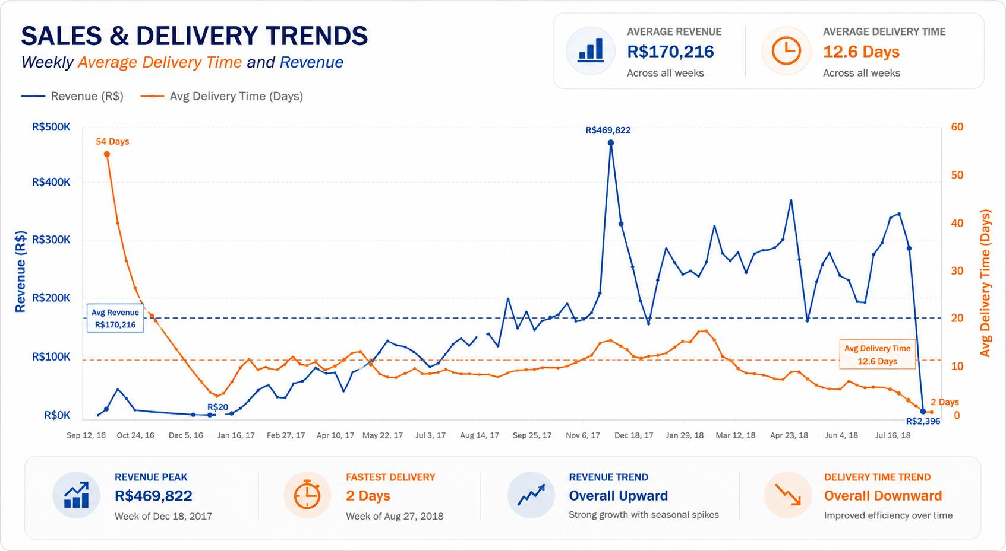
TRENDS
Revenue Climbed While Delivery Time Collapsed
R$ 469.8K
Peak weekly revenue (week of Dec 18, 2017)
R$ 170.2K
Average weekly revenue across the period
54 → 2 days
Delivery time from start to end of period
12.6 days
Overall average delivery time, trending down
5
Notes:
This is my favorite chart in the whole analysis, because it tells two stories at once. The blue line is weekly revenue; the orange line is average delivery time. Revenue shows a strong, consistent upward trend across the two years, with some seasonal spikes — the biggest being the week of December 18th, 2017, at nearly 470 thousand reais. Average weekly revenue was around 170 thousand. Meanwhile the orange line goes the opposite direction: average delivery time started at 54 days at the very beginning of the marketplace, and by the end of the period it was down to just 2 days. The overall average settled at 12.6 days, on a clear downward trend. So as logistics matured, sales grew — the two curves crossing is really the story of this marketplace scaling up. [~70 seconds]

Slide 6
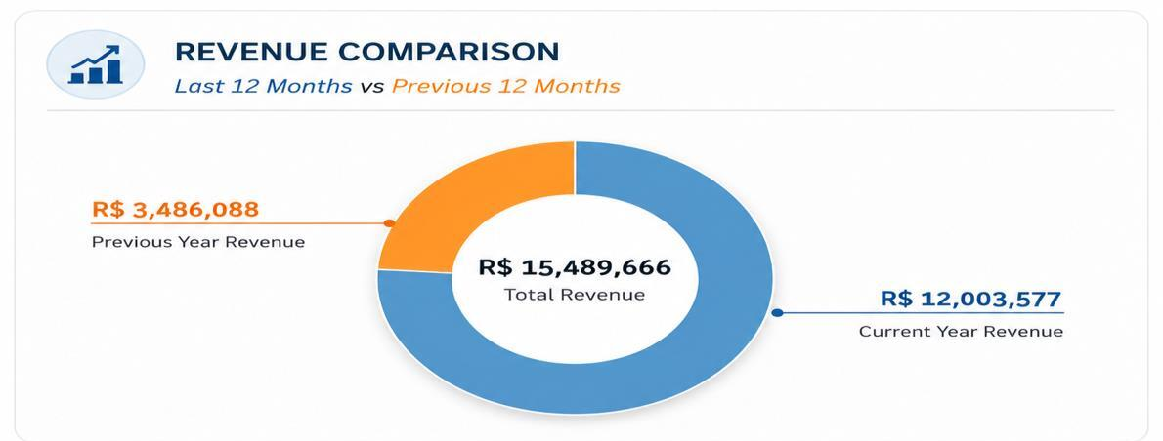
GROWTH
Year-over-Year: Revenue Up ~244%
R$ 3.49M → R$ 12.00M
Previous 12 months vs. most recent 12 months
+244%
77.5% of all revenue came from the latest 12-month period — clear evidence of rapid expansion.
Cumulative revenue reached R$ 15.49M across the full analysis window.
6
Notes:
Zooming out to a year-over-year view makes the growth even clearer. In the earlier twelve months, the marketplace generated three point four nine million reais. In the most recent twelve months, that jumped to twelve million — an increase of roughly 244 percent. Put another way, the latest year alone accounts for about 77 and a half percent of everything the marketplace has ever earned in this dataset. That's the signature of a business in genuine expansion mode, not just steady-state growth — and it raises the question of what was enabling it operationally, which brings us to delivery performance. [~45 seconds]

Slide 7
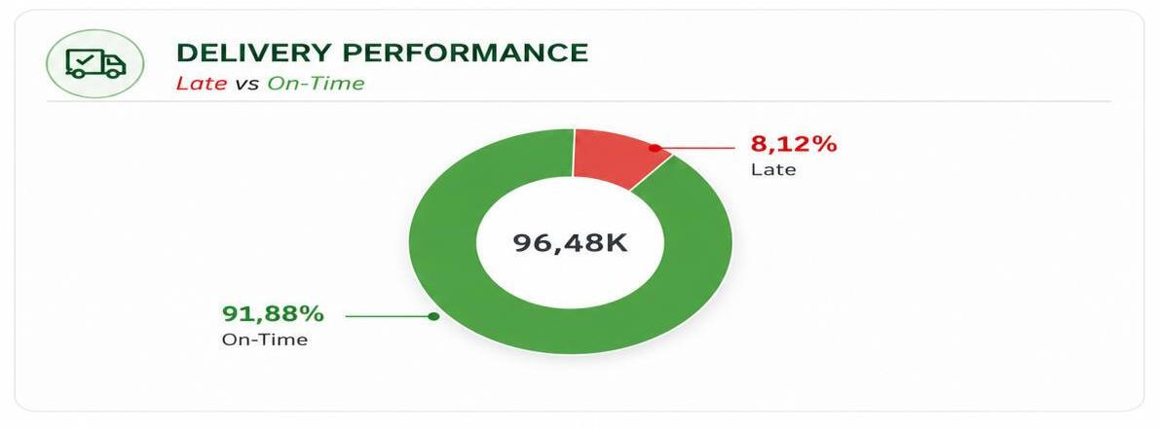
OPERATIONS
Deliveries: 9 in 10 Orders Arrive On Time
91.88%
of ~96.5K orders delivered on or before the estimated date
8.12%
late deliveries — low, and shrinking as logistics improved
Reliable fulfillment underpins the 4.08★ average review score — delivery experience and customer satisfaction move together.
7
Notes:
So how reliable was fulfillment while the business was tripling? Very. Out of roughly ninety-six and a half thousand orders, 91.88 percent were delivered on time — on or before the estimated delivery date the customer was shown. Only 8.12 percent arrived late. For a marketplace model, where fulfillment depends on thousands of independent sellers shipping across a country the size of Brazil, that's a strong result. And it matters beyond logistics: delivery experience is one of the strongest drivers of review scores. That 4.08-star average we saw earlier rests heavily on this on-time performance. Improvements in logistics supported both the sales growth and customer satisfaction. [~50 seconds]

Slide 8
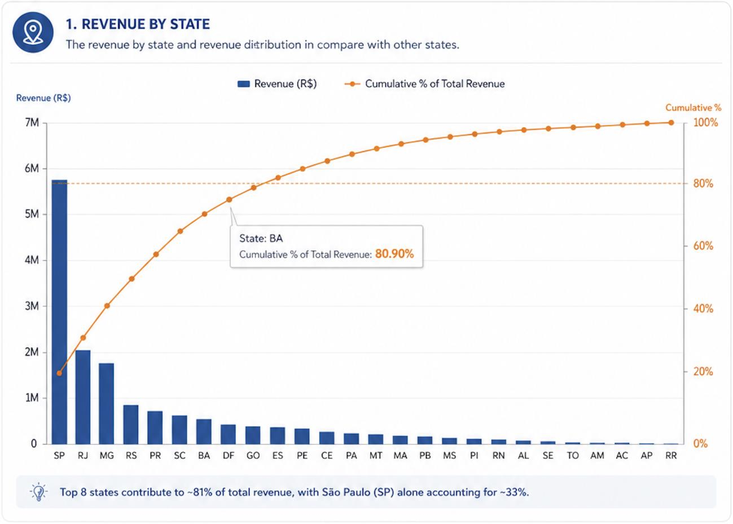
PARETO ANALYSIS · GEOGRAPHY
8 States Generate ~81% of Revenue
~33%
of total revenue comes from São Paulo alone — the single dominant market
SP · RJ · MG
lead a highly concentrated distribution of sales
81% / 19%
top 8 states vs. all remaining states — a classic 80/20 split
Long tail of low-performing regions = headroom for targeted regional growth
8
Notes:
Now, where does the money come from geographically? The answer is: a surprisingly small number of places. São Paulo alone generates roughly a third of all revenue — it towers over every other state. Add Rio de Janeiro and Minas Gerais and you've covered the biggest share of sales. Following the classic Pareto 80/20 principle, the top eight states account for about 81 percent of total revenue, leaving only around 19 percent for all the rest. After the leaders, revenue drops off sharply into a long tail of low-performing regions. Strategically that cuts two ways: we need to protect engagement in the core markets, but that long tail also represents real headroom for regional marketing and seller acquisition. [~55 seconds]

Slide 9
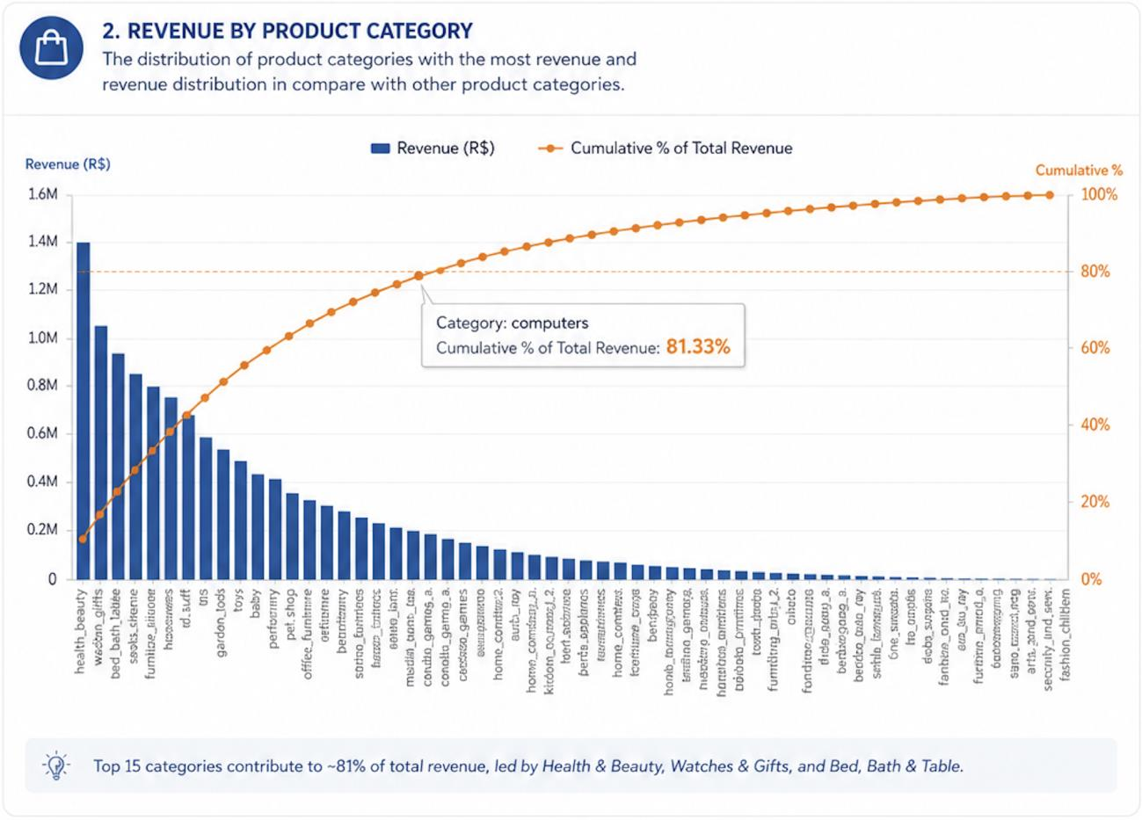
PARETO ANALYSIS · PORTFOLIO
15 Categories Drive ~81% of Revenue
#1 Health & Beauty
top category, ahead of Watches & Gifts and Bed, Bath & Table
Top 15 ≈ 81%
of revenue; remaining ~55 categories share <20%
Long-tail portfolio
many niche categories with comparatively low sales
Skewed distribution → focus visibility and promotion on categories with breakout potential
9
Notes:
The exact same pattern shows up in the product portfolio. Health and Beauty is the single biggest revenue generator, followed by Watches and Gifts, and Bed, Bath and Table. Revenue across categories is highly skewed: the top fifteen product categories contribute approximately 81 percent of total revenue, while all the remaining categories combined contribute less than 20. After the leaders, revenue decreases steadily into a long tail of niche categories. So the portfolio mirrors the geography — concentration at the top, opportunity in the tail. The playbook is to keep strengthening the proven winners while using promotion and better product visibility to test which of the smaller categories can break out. [~50 seconds]

Slide 10
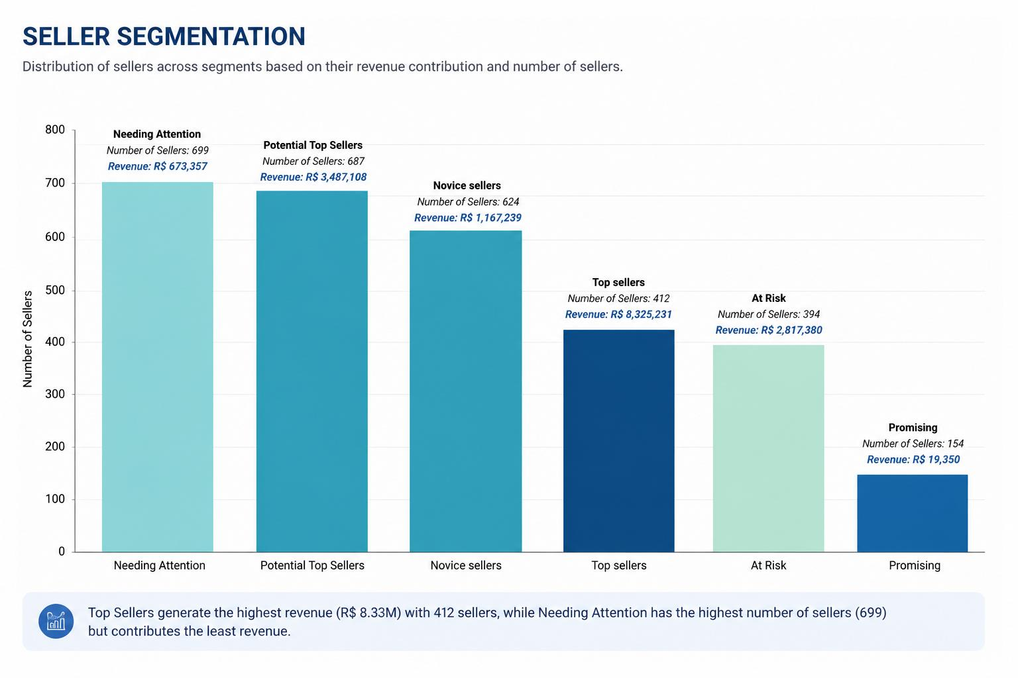
SELLER ECOSYSTEM
RFM Segmentation: 412 Sellers Carry the Marketplace
Segment | Sellers | Revenue
Top Sellers | 412 | R$ 8.33M
Potential Top | 687 | R$ 3.49M
At Risk | 394 | R$ 2.82M
Novice | 624 | R$ 1.17M
Needs Attention | 699 | R$ 673K
Promising | 154 | R$ 19K
14% of sellers → over half of all revenue
10
Notes:
Finally, the supply side. Using the RFM model — recency, frequency, and monetary value — I classified all sellers into six performance groups. The headline: Top Sellers, just 412 of them, generate 8.33 million reais — that's 14 percent of the seller base producing more than half of all marketplace revenue. Behind them, 687 Potential Top Sellers contribute nearly 3.5 million, and they're the most promising group to develop. On the risk side, 394 At-Risk sellers still generate 2.8 million, so retention there protects real money. And the largest segment by headcount — Needs Attention, with 699 sellers — contributes only 673 thousand. Novice and Promising sellers contribute the least, which makes them candidates for onboarding and development programs. [~65 seconds]

Slide 11
SYNTHESIS
Five Conclusions from Two Years of Data
1
Rapid growth
R$ 15.49M total revenue; +244% in the latest 12 months vs. the prior year.
2
Logistics transformed
Delivery time fell from 54 days to 2; 91.9% of orders on time.
3
Pareto everywhere
Top 8 states ≈ 81% of revenue; top 15 categories ≈ 81% of revenue.
4
Concentrated supply
Top Sellers — a small share of the base — generate over half of revenue.
5
Satisfied customers
4.08/5 average rating, supported by improving delivery experience.
11
Notes:
Let me pull the threads together into five conclusions. One: this is a business in rapid growth — fifteen and a half million in total revenue, up 244 percent year over year. Two: operations transformed alongside it. Delivery time collapsed from 54 days to 2, while nearly 92 percent of orders arrived on time. Three: revenue follows the Pareto principle wherever you look — eight states and fifteen categories each cover about 81 percent of sales. Four: the supply side is just as concentrated — top sellers, a small fraction of the base, generate more than half of revenue. And five: customers are broadly satisfied at 4.08 stars, which the improving delivery experience clearly supports. [~55 seconds]

Slide 12
NEXT STEPS
Six Recommendations to Sustain Growth
Grow underperforming regions
Back winning categories
1
2
Localized marketing, promotions, and seller acquisition beyond the top states.
Strengthen leaders; lift promising niches via promotion and visibility.
Retain Top Sellers
Develop emerging sellers
3
4
Loyalty programs, incentives, and dedicated support for the biggest contributors.
Training and operational guidance to reduce dependence on a small elite.
Keep optimizing logistics
Operationalize the dashboard
5
6
Protect the on-time rate and push late deliveries below 8%.
Use Tableau for continuous KPI monitoring and proactive decisions.
Thank you — questions welcome
Notes:
So what should the business actually do? Six things. First, invest in the underperforming regions — localized marketing, promotions, and seller acquisition outside the top states, because that long tail is untapped demand. Second, strengthen the winning product categories while giving promising niches more visibility. Third, protect the crown jewels: retain top sellers with loyalty programs, incentives, and dedicated support. Fourth, develop mid-tier and emerging sellers through training and guidance, so revenue isn't dependent on such a small group. Fifth, keep investing in logistics — the on-time rate is a competitive asset worth defending. And sixth, make the Tableau dashboard part of the operating rhythm, so these KPIs are monitored continuously rather than analyzed once. Overall, this analysis shows how data-driven decision-making can connect sales, logistics, customer experience, and seller performance into one coherent growth story. Thank you — happy to take questions. [~75 seconds]

